Slide 1

The 5 A strategy and Very brief advice (VBA)
Alexander Thomas Mboma, MPH
Center for Development Management (CDM)
Notes:
This session is designed to ensure that you are familiar with best practices for tailoring tobacco dependence treatment to best meet the needs of people who want to quit with a focus on the initial assessment
We will look specifically at the initial assessment or your initial contact with patients.
Focussing on best practices and communications skills for engaging people who smoke.
We consider what key information is needed to tailor treatment to the patient’s individual needs and we will also spend some time discussing consideration for smoking and psychotropic medications.

Slide 2
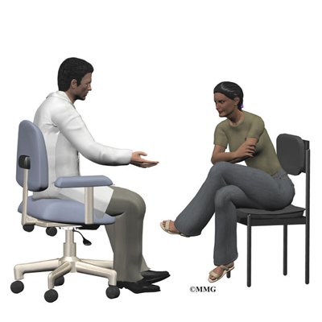
Module Objective
  Apply 5A strategy and Very Brief Advice (VBA) in routine care.
  Handle resistance and relapse with empathy.
  Plan structured follow-ups.

Slide 3

The 5 A STRATEGY for TREATING TOBACCO
Ask about tobacco use
  Systematically identify all tobacco users at every visit.
Advise tobacco users to quit
Assess readiness, or willingness to make a quit attempt
Assist with the quit attempt
  Provide counseling and medication
Arrange follow-up care

Slide 4

THE 5A’s: ASK
Ask about tobacco use
  a tone that conveys sensitivity.
  concern and is non-judgmental.
    “Do you smoke or use other types of tobacco or nicotine, such as e-cigarettes?”
    “It’s important for us to have this information so we can check for potential interactions between tobacco smoke and your other medicines.”
    “We ask all of our patients, because tobacco smoke can affect how some medicines work.” “We care about your health, and we have resources to help our patients quit smoking.”
    “Has there been any change in your smoking status?”

Slide 5

The 5 A’s: ADVISE
Advise tobacco users to quit.
  clear, strong, personalized.
    “quitting smoking is the most important thing you can do to protect your health now and in the future.”
    “I have training to help my patients quit, and when you are ready, I can work with you to design a specialized treatment plan.”
Studies have shown that 52% of psychiatric patients who smoke report never having been advised to quit by a mental healthcare provider.

Slide 6
The 5 A’s: ASSESS and ASSIST
Assess
  Readiness to make a quit attempt.
Assist with the quit attempt.
  Not ready to quit: enhance motivation.
  Ready to quit: design a treatment plan.
  Recently quit: relapse prevention.

Slide 7
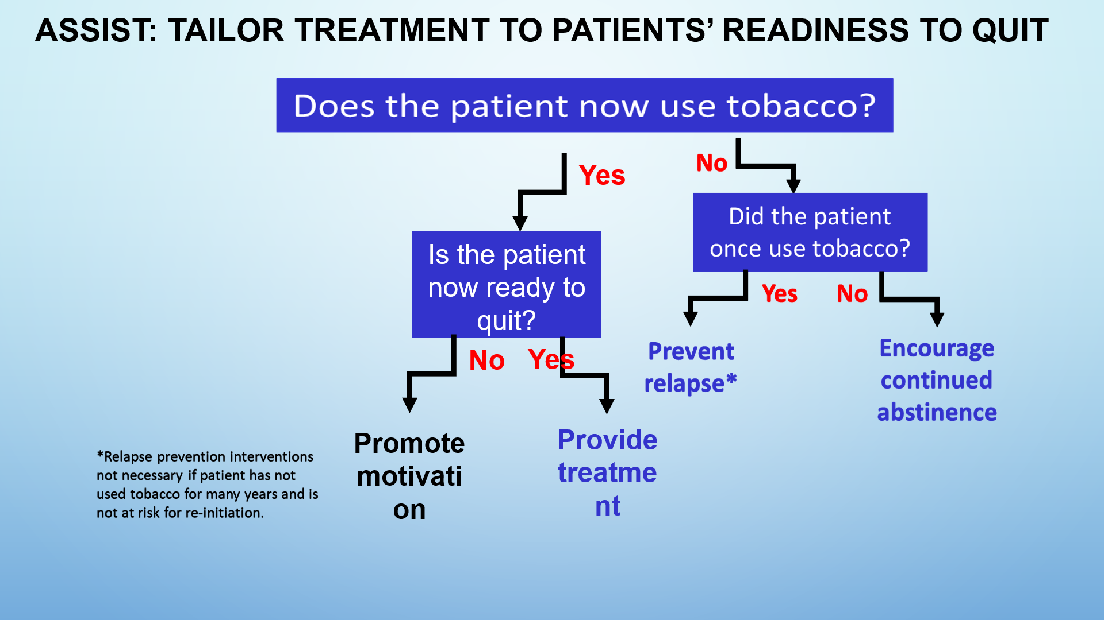

Slide 8
Very Brief Advice (VBA) for Smoking Cessation
A WHO-Recommended, life-saving intervention

Slide 9
What is Very Brief Advice?
A simple, opportunistic intervention for use in any patient consultation.
Designed to be delivered in less than 30 seconds.
Based on evidence-based recommendations from the WHO.

Slide 10
The VBA model: ASK, ADVISE, ACT
The 3 A's: ASK, ADVISE, ACT
ASK: Ask and record smoking status (e.g., "Do you smoke?").
ADVISE: Advise that the most effective way to quit is with support and medication.
ACT: Act by referring the patient to appropriate local stop-smoking support.

Slide 11
ASK - Establishing smoking status
Step 1: ASK
  Routinely ask about smoking status at every encounter.
  Record the patient's smoking status clearly in their notes.
  Use a simple, direct question like, "Do you smoke?".

Slide 12
ADVISE - Giving clear advice
Step 2: ADVISE
  State clearly that stopping smoking is the most important thing they can do for their health.
  Explain that a combination of behavioral support and medication is most effective.
  Correct misconceptions (e.g., that e-cigarettes are just as harmful as traditional cigarettes).

Slide 13
ACT - Referring to support
Step 3: ACT
  Based on the patient's readiness, refer them to support services.
  This could include local stop-smoking clinics, helplines, or online resources.
  Offer to help them make the appointment or provide them with the contact information.

Slide 14
Benefits of VBA
Why VBA is so effective
  Increases quit attempts.
  Is a cost-effective intervention.
  Can be delivered by any healthcare professional, making it a part of every patient visit.
  Provides a gateway to more intensive support.

Slide 15
VBA for smoking cessation is about….
Raising the issue, routinely asking smoking status.
Exploring what smoking means to the individual.
Enabling the smoker to believe that they could stop smoking if they choose to do so.
Checking levels of knowledge and beliefs about smoking.
Correcting misinformation.
Giving further information, advice and support.
Outlining the benefits of getting help and making quitting easier for them if they access the service.
Referring to stop smoking service.

Slide 16
Stop smoking interventions
Brief interventions:
Brief opportunistic advice provided by front line staff coming into contact with smokers.
Smokers are asked about their smoking status and given relevant information.
Smokers are signposted/referred to relevant stop smoking service.
Intermediate interventions:
Delivered by level 2 advisors.
Offering one to one sessions which include preparation and setting a quit date, advice on medications, behavioural support and follow up sessions.

Slide 17
Stop smoking interventions cont.
Specialist interventions delivered by Specialist Stop Smoking Services:
Smokers with complex needs.
Further support e.g. heavy smoker/one who has tried unsuccessfully to quit before.
Specialist support for language/culture.
1:1 and group sessions.
Pregnant
Mental health patients
It’s also a service of choice.

Slide 18
Role of frontline healthcare workers
Integrate the ASK, ADVISE, ACT model into your daily workflow.
Providing high quality Very Brief Advice on benefits of stopping smoking and the most effective way to stop and stay stopped, which is with support and medication.
Recording smoking status in the patient health passport book or medical records.
Familiarize yourself with hospital-based stop-smoking services.
Practice delivering the 30-second intervention.

Slide 19

Congratulations! You’ve completed Module 5.

