Slide 1

Integrating Cessation Counselling into Routine Clinical Care
Alexander Thomas Mboma, MPH
Center for Development Management (CDM)

Slide 2
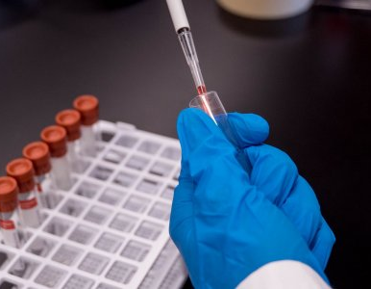
Module Overview
Learning Outcomes:
1. Identify points of care where counselling fits naturally.
2. Apply the 5A’s and VBA frameworks efficiently during consultations.
3. Utilize documentation and referral systems.
4. Integrate cessation support into NCD, HIV, TB, and maternal health programs.
To equip healthcare workers with the skills to embed brief tobacco cessation counselling within daily patient care routines.

Slide 3
Why integration of cessation counselling
Tobacco use contributes to >12% of NCD-related deaths in Malawi.
Every patient contact is an opportunity to intervene.
Integration ensures systematic identification and consistent delivery of counselling.
If we don’t ask, we miss the chance to help.

Slide 4
The 5A’s Framework in clinical context
Ask
Advise
Urge to quit clearly and personally.
Assess
Readiness to quit using a 1–10 scale.
Assist
Offer brief support or NRT.
Arrange
Schedule follow-up or referral.
Identify tobacco use at triage or intake.

Slide 5
Very Brief Advice counselling in 3–5 minutes
Step 1
Ask and document tobacco use.
Step 2
Advise and link to benefits of quitting.
Step 3
Assess readiness to quit.
Step 4
Offer practical support or referral.
Step 5
Record in patient file.
Every contact counts!

Slide 6
Documentation and Monitoring
Use HMIS forms or facility registers.
Record tobacco use, counselling provided, referral made.
Data supports quality improvement and national reporting.

Slide 7
How Malawi can leverage emerging digital health systems to improve cessation care.
Currently, most health facilities record tobacco use manually.
Future considerations to integrate cessation data (Leverage on expansion of DHIS2 and mHealth systems)
DHIS2 could include a tobacco cessation module (just as it currently does for HIV and maternal health indicators)

Slide 8
Brainstorm session
How can we integrate tobacco cessation data into part of broader digital NCD initiatives?
What kind of digital tools would make cessation follow-up easier?
How could existing tools like DHIS2, or WhatsApp groups be adapted for tobacco cessation and counselling?
What challenges (connectivity, literacy, funding) need to be addressed first?

Slide 9
Overcoming Integration challenges
Potential challenges and their proposed mitigation strategies
Potential Challenges | Mitigation strategies
Limited time | Embed in triage.
Competing priorities | Link to chronic care
Lack of training | Use e-learning modules.
Poor documentation | Simplify digital entry
Low motivation | Apply motivational interviewing.
Notes:
Engage learners in discussing barriers. Ask them to suggest solutions relevant to their facility context.

Slide 10
Digital and Referral support
Use mobile reminders and WhatsApp peer groups.
Electronic registers for tracking follow-ups.
Referral pathways in Malawi health systems set up:
Cessation clinics (Mental health coordinators)
NCD coordinators
Volunteers.

Slide 11
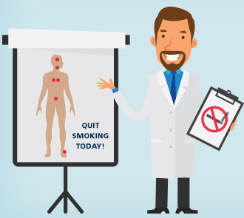
Case study
Mr Lameck, 45-year-old male with hypertension, smokes 10 cigarettes/day.
At OPD during vital signs taking, Nurse asks, records tobacco use.
During NCD clinic review: CO advises on quitting.
Before leaving, patient is referred to mental health (cessation) clinic.
Integration achieved without disrupting workflow.

Slide 12
Reflection and Discussion
How can you integrate counselling in your setting?
What barriers exist in your facility?
What tools would make integration easier?

Slide 13
Thank you for completing Module 7

