Slide 1

Relapse Prevention and Long-term Follow-Up
Alexander Thomas Mboma, MPH
Center for Development Management (CDM)

Slide 2

Module Objectives
Define relapse and its psychological stages.
Identify behavioral and pharmacological prevention strategies.
Develop structured follow-up systems for clients.
Apply Malawi’s national tobacco counselling guidelines in follow-up care.
Notes:
Understand relapse as part of the quitting process.
Learn strategies for supporting long-term abstinence.
Integrate relapse prevention into clinical practice.
Identify tools for effective client follow-up in Malawi’s health system.

Slide 3
Why Relapse Prevention Matters
Relapse is common
  70–80% of quitters relapse within six months.
Relapse undermines patient confidence and increases NCD risks.
Healthcare workers play a key role in sustained behavior change.
Notes:
Discuss why relapse prevention is a public health priority in Malawi.

Slide 4
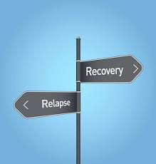
Understanding Relapse
Relapse = return to tobacco use after a quit attempt.
Common triggers include:
  Stress, social cues, alcohol, emotional distress.
Relapse is feedback, not failure.

Slide 5
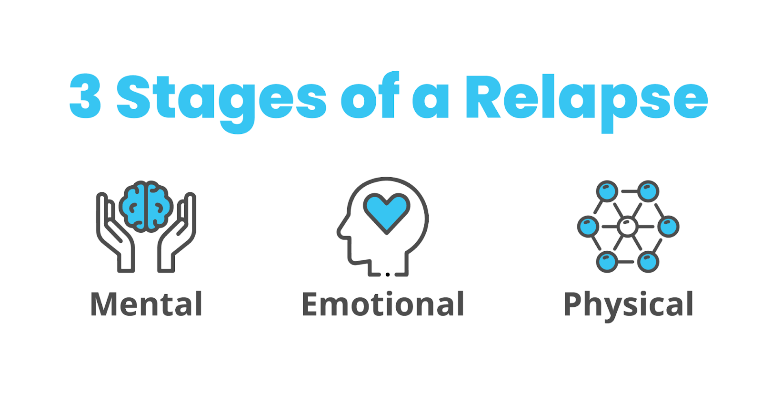
Stages of Relapse
Emotional relapse
  Poor coping under stress.
2. Mental relapse
Internal struggle, craving thoughts.
3. Physical relapse
Actual smoking or chewing tobacco.
Notes:
Explain each stage and stress early detection.

Slide 6
Behavioral Model of Relapse
Relapse results from a combination of triggers, coping deficits, and lack of support.
Goal: Strengthen coping and support mechanisms.

Slide 7
Triggers in the Malawian Context
Social gatherings where smoking is common.
Stress from economic hardship.
Peer pressure among men in rural areas.
Alcohol consumption and nightlife settings.

Slide 8
The Role of Healthcare Providers
Ask every patient about tobacco use history.
Provide ongoing encouragement and relapse counselling.
Link clients to cessation resources and peer groups.

Slide 9
Core Principles of Relapse Prevention
Empathy and non-judgment.
Consistency in follow-up.
Patient-centered support.
Behavioral reinforcement of positive change.

Slide 10
Behavioral Strategies for Prevention
Teach self-monitoring and awareness of triggers.
Promote coping techniques such as relaxation, exercise, and social support.
Encourage positive reinforcement and self-efficacy.

Slide 11
Coping skills in practice
Deep breathing and relaxation techniques.
Substitute activities
  Drinking water, short walks.
Delay strategy
  Postpone smoking urges for 10 minutes.

Slide 12
Motivational Interviewing Techniques
Use open-ended questions and reflective listening.
Avoid confrontation; focus on intrinsic motivation.
Celebrate small wins and effort.

Slide 13
Building social support networks
Encourage family engagement in quitting process.
Create peer groups in clinics and communities.
Utilize WhatsApp or SMS support channels.

Slide 14
Setting realistic Goals
Focus on small steps rather than all-or-nothing.
Help clients plan coping strategies for high-risk situations.
Reinforce each attempt as progress.

Slide 15
Reward and Reinforcement
Encourage self-reward for milestones (e.g., 1 week smoke-free).
Use community recognition or clinic rewards.
Link to improved health indicators like BP or glucose control.

Slide 16

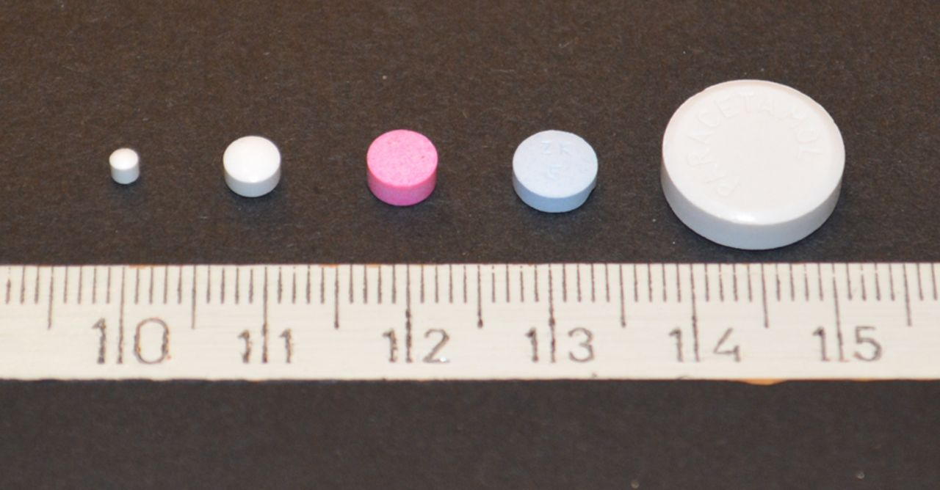

Pharmacological Support in Relapse Prevention
Use Nicotine Replacement Therapy (NRT) where available.
Consider reintroducing pharmacotherapy post-relapse.
Combine behavioral and pharmacological approaches.

Slide 17
Monitoring Adherence to Medication
Ask clients about side effects and adherence challenges.
Use pill counts or refill monitoring.
Provide reassurance about safety and duration.

Slide 18
When to Restart Treatment
Restart therapy after relapse if client is ready to try again.
Adjust dosage or method as needed.
Maintain encouragement and celebrate re-engagement.

Slide 19
Structuring Follow-Up Systems
Initial follow-up within 1 week of quit date.
Subsequent follow-ups at 1, 3, 6, and 12 months.
Combine physical and virtual contact.

Slide 20
Integrating Follow-Up into Routine Care
Add tobacco status check to chronic disease reviews.
Use EMR flags or HMIS codes for follow-up reminders.
Collaborate with NCD clinic teams and CHWs.

Slide 21
Digital Follow-Up Tools
SMS or WhatsApp check-ins for encouragement.
Digital patient logs to track progress.
Simple mobile dashboards for reporting outcomes.

Slide 22
Documentation and Data Use
Record relapse and follow-up outcomes.
Use data to identify success patterns.
Report monthly to district NCD coordinators.

Slide 23
Managing Relapse Compassionately
Acknowledge effort, avoid blame.
Explore reasons for relapse collaboratively.
Restart plan and set a new quit date.

Slide 24
Case Scenario 1
A 45-year-old man relapses after stress at work.
Discuss how to address stress management.
Outline a revised counselling plan.

Slide 25
Case Scenario 2
A woman in a TB clinic relapses during treatment.
Integrate cessation counselling into TB adherence sessions.
Plan multi-disciplinary follow-up.

Slide 26
Community-Based Follow-Up
Engage HSAs and peer educators.
Conduct home visits and community support groups.
Link to district cessation champions.

Slide 27
Referral and Support Pathways
Refer complex cases to district hospitals or cessation centers.
Use established MoH referral forms.
Document and track referral feedback.

Slide 28
Reflection and Discussion
What barriers do you face in supporting clients long-term?
How can digital tools help in your facility?
What community partnerships could support follow-up?

Slide 29
Knowledge Check 1
What are the three stages of relapse?
a. Emotional, Mental, Physical (Correct).
2. What is the recommended initial follow-up period after a quit attempt?
a. Within one week (Correct).
3. Which of the following is NOT a relapse prevention strategy?
a. Ignoring withdrawal symptoms (Correct).
4. What is the most important approach to a client who relapses?
a. Compassionate, non-judgmental support (Correct).
5. What digital tool can support follow-up in Malawi?
a. SMS reminders / WhatsApp groups (Correct).

Slide 30
Thank you for completing Module 8

