Slide 1

Ethical, Cultural and Psychological Considerations in Tobacco cessation
Alexander Thomas Mboma, MPH
Center for Development and Management (CDM)

Slide 2
Module Objectives
  Apply ethical principles in cessation practice.
  Address stigma and ensure confidentiality.
  Adapt counselling to cultural and gender contexts.
  Understand key ethical principles in tobacco cessation.
  Explore common ethical dilemmas in tobacco harm reduction.
  Understand the cultural factors that influence tobacco use.

Slide 3
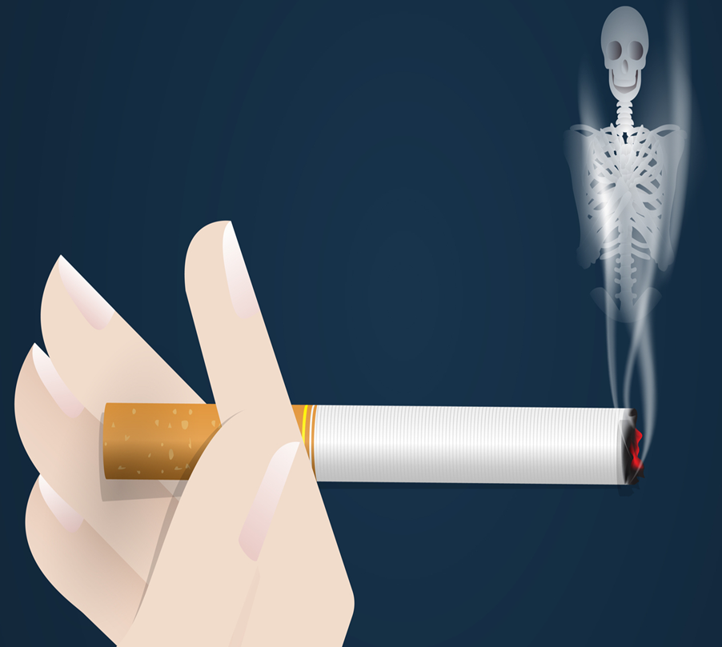
Ethical Considerations in Tobacco Cessation
Why Ethics Matter in Tobacco cessation
Foundation of trust in healthcare
Sensitive nature of addiction
Respect for autonomy
Non-judgmental support
Guidelines for beneficence and non-maleficence
Fair access to care
Notes:
Foundation of trust in healthcare
Ethical practices build trust between healthcare providers and patients.
Patients are more likely to engage in cessation programs when they feel respected and supported.
Sensitive nature of addiction
Tobacco dependence is a complex addiction involving physical, psychological, and social factors.
Ethical approaches are essential for addressing the vulnerability of individuals undergoing behavior change.
Respect for autonomy
Ethics guide providers to respect each individual's right to make informed choices about their health.
Ensures that patients are not coerced but are empowered to make decisions based on their values and needs.
Non-judgmental support
Ethical approaches emphasize empathy and understanding, creating a non-judgmental environment.
Reduces stigma and allows patients to openly discuss challenges and relapse risks.
Guidelines for beneficence and Non-maleficence
Ethical practices ensure that interventions aim to benefit the patient without causing harm.
Balances the promotion of health benefits (beneficence) with the avoidance of potential harm (non-maleficence) in cessation strategies.
Fair Access to Care
Ethics help ensure equitable access to cessation support for all patients, regardless of socioeconomic or demographic background.

Slide 4


What are Ethics in Healthcare?
  Healthcare ethics
  Involves ensuring respect, autonomy, fairness, and the well-being of patients.
  Moral principles that govern behavior.

Slide 5
Key Ethical Principles in Tobacco Cessation
Autonomy
Respecting a client's right to make their own decisions.
Beneficence
Acting in the best interest of the client.
Non-Maleficence
Avoiding harm to clients.
Justice
Ensuring fairness and equity in treatment.

Slide 6
Respecting Patient Autonomy
Clients have the RIGHT to choose whether to quit or reduce tobacco use.
Healthcare providers should INFORM and SUPPORT, not COERCE.
Example
  Respecting a client’s decision not to quit immediately.

Slide 7


Beneficence and Non-Maleficence
Beneficence
  Helping clients to improve their health by quitting or reducing tobacco use.
  Ensuring interventions do not cause harm, such as emotional distress or undue pressure.
Example
Avoiding aggressive tactics that may push clients away.
Non-Maleficence

Slide 8

Principle of Justice in Tobacco Cessation
Fair access to treatment options for all, regardless of background.
Addressing disparities in tobacco use among different populations.
Example
Ensuring services are accessible to marginalized communities.

Slide 9

Confidentiality and Privacy
Importance of maintaining patient confidentiality.
Handling sensitive information with care.
Legal obligations to protect client data.

Slide 10

Informed Consent in Tobacco Cessation
Clients must be fully informed about treatment options, risks, and benefits.
Respect the client’s right to CONSENT or REFUSE treatment.
Example
  Discussing all cessation options, including harm reduction methods.

Slide 11

Ethical Dilemmas in Tobacco Cessation
Addressing conflicts between public health goals and individual autonomy.
Navigating coercion vs. encouragement in treatment approaches.
Managing cases where clients are unwilling to quit completely.

Slide 12
Ethical Challenges with Harm Reduction
Harm Reduction vs. Cessation: Ethical Considerations
Is promoting e-cigarettes or nicotine patches as a harm reduction tool ethical?
Balancing harm reduction with the goal of complete cessation.
Example
  Advising smokers who are not ready to quit entirely to switch to less harmful products.

Slide 13
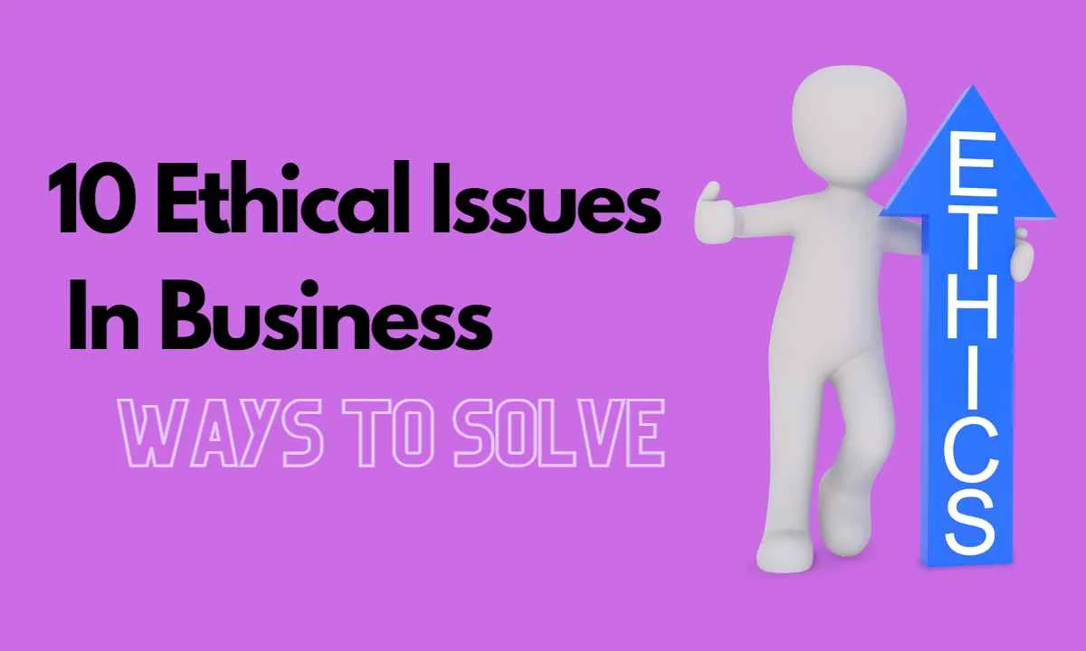
Addressing Ethical Challenges
Open communication and non-judgmental support.
Using motivational interviewing to respect autonomy while encouraging change.
Developing clear policies and protocols to navigate ethical dilemmas.

Slide 14

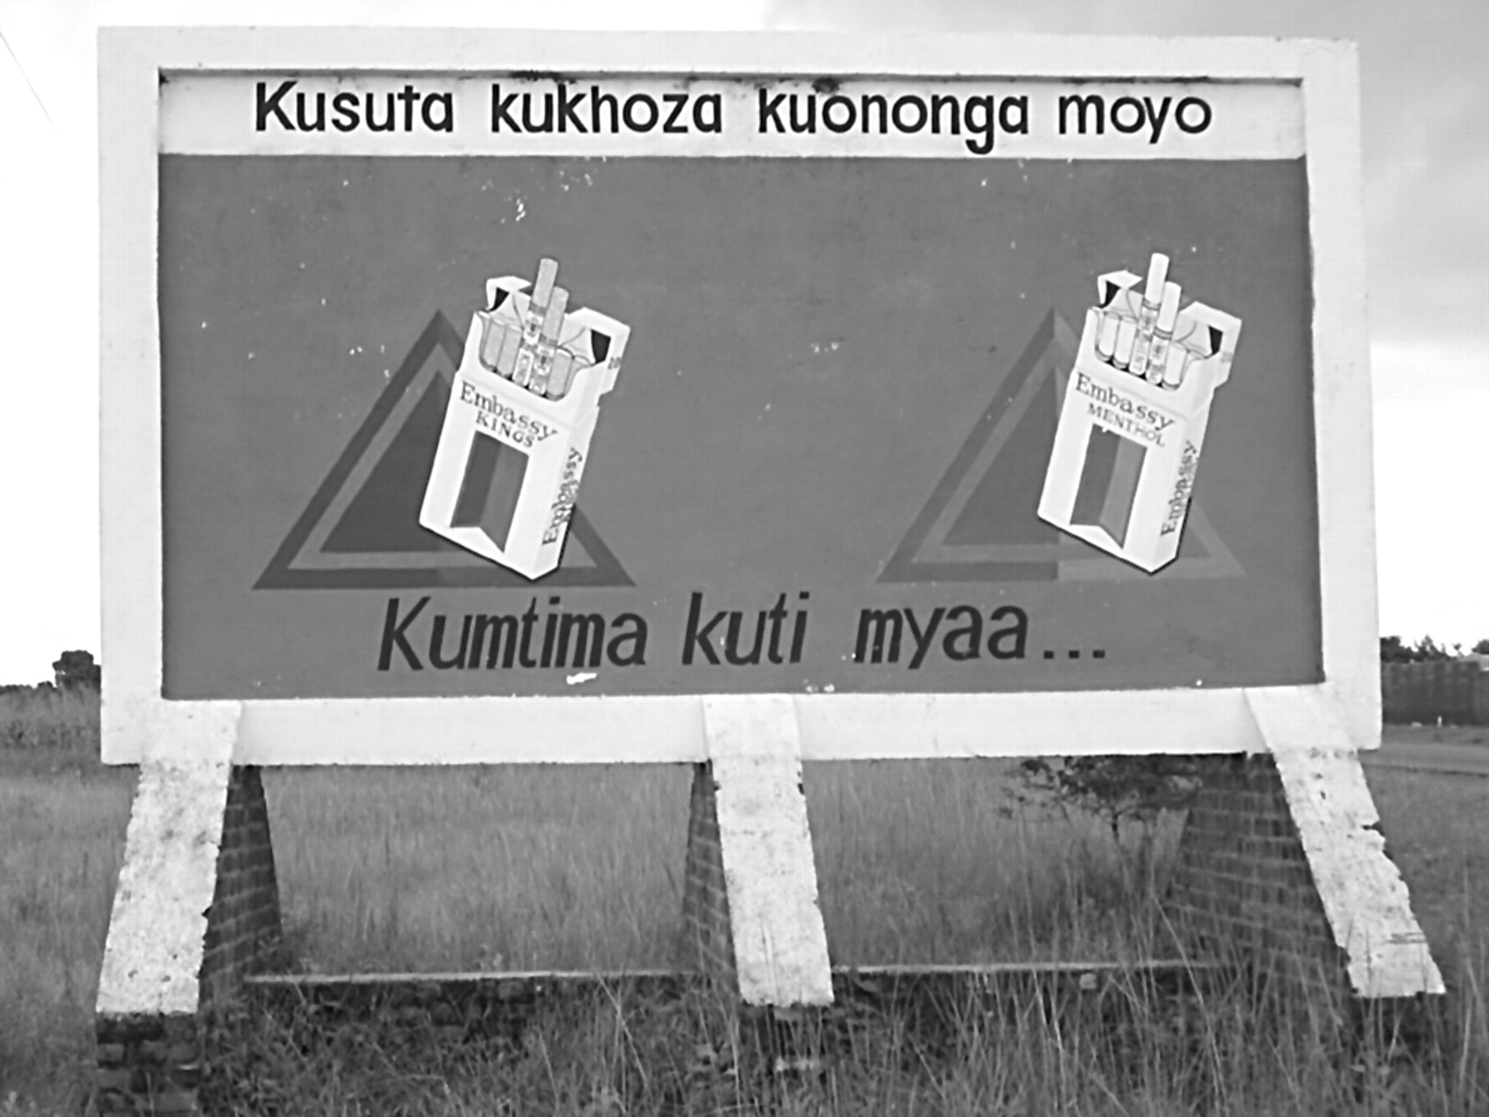

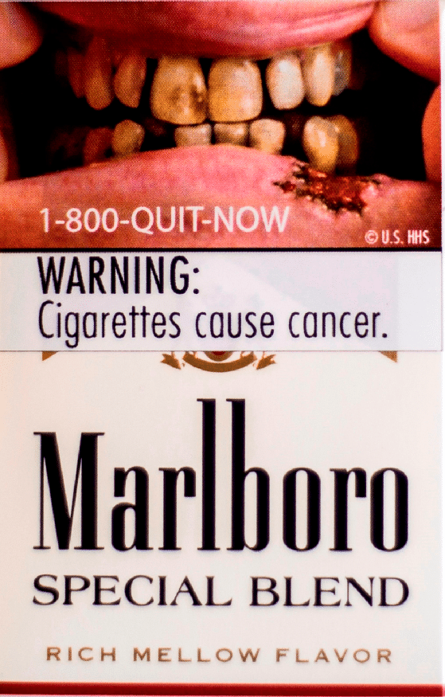
Ethical Marketing of Tobacco cessation products
Ethical considerations when promoting cessation aids (e.g., patches, gum, e-cigarettes).
Avoid misleading claims or overstating benefits.
Example
Ensuring transparency about the effectiveness and risks of cessation products.

Slide 15

Handling relapse with compassion
Acknowledge that relapse is common and part of the process.
Provide continued support without judgment or guilt.
Example
Helping clients develop relapse prevention plans without shaming them.

Slide 16
Ethical considerations for Vulnerable Populations
Extra care when addressing cessation in pregnant women, youth, and individuals with mental health conditions.
Ensure interventions do not exploit vulnerabilities.
Example
Tailoring messages for teens to avoid stigmatization.

Slide 17
Case Study
Scenario
    Yohane, is heavily dependent on smoking but is unwilling to quit; he expresses interest in using e-cigarettes as a harm reduction strategy.
Discussion Points
    How would you balance supporting harm reduction with encouraging complete cessation?
    How can you ensure respect for the client’s autonomy?

Slide 18
Best practices for Ethical Tobacco Cessation
Transparency
  Be clear about the pros and cons of all treatment options.
Empathy and understanding
  Provide compassionate care without judgment.
Continual education
  Stay updated on ethical standards and guidelines.

Slide 19
KEY TAKE AWAYS
Ethical practice ensures trust, respect, and effective client support.
Balancing autonomy with health goals is crucial.
Use clear communication, cultural sensitivity, and a non-judgmental approach.

Slide 20
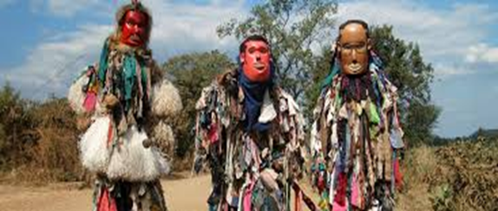
Cultural and Socioeconomic factors in Tobacco use

Slide 21
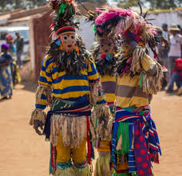
Cultural Sensitivity in Tobacco Cessation
Respect cultural beliefs and practices related to tobacco use.
Understand the cultural context when recommending cessation strategies.
Example
  Tailoring cessation approaches to fit cultural preferences.

Slide 22
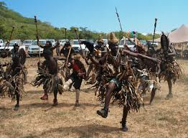
Cultural factors in Tobacco use
Cultural norms and beliefs play a significant role in shaping attitudes and behaviors related to tobacco use.
In some cultures (Chewa and Ngoni), tobacco use is deeply ingrained in social practices and rituals.
Social norms and peer pressure can strongly influence tobacco use, particularly among adolescents and young adults.
The desire to fit in with peers can lead to the initiation and continuation of smoking.

Slide 23

Examples of cultural norms and beliefs related to tobacco use in Malawi
Traditional or religious practices
In some indigenous cultures and religion (Rastafarian), tobacco (Mariuana) is used in religious and ceremonial practices.
Social acceptance
In certain societies, smoking is seen as a social activity and a symbol of status or maturity.
Gender norms
Cultural beliefs about gender roles can influence tobacco use, with smoking being more acceptable for men than women in Malawi and similar cultures.

Slide 24
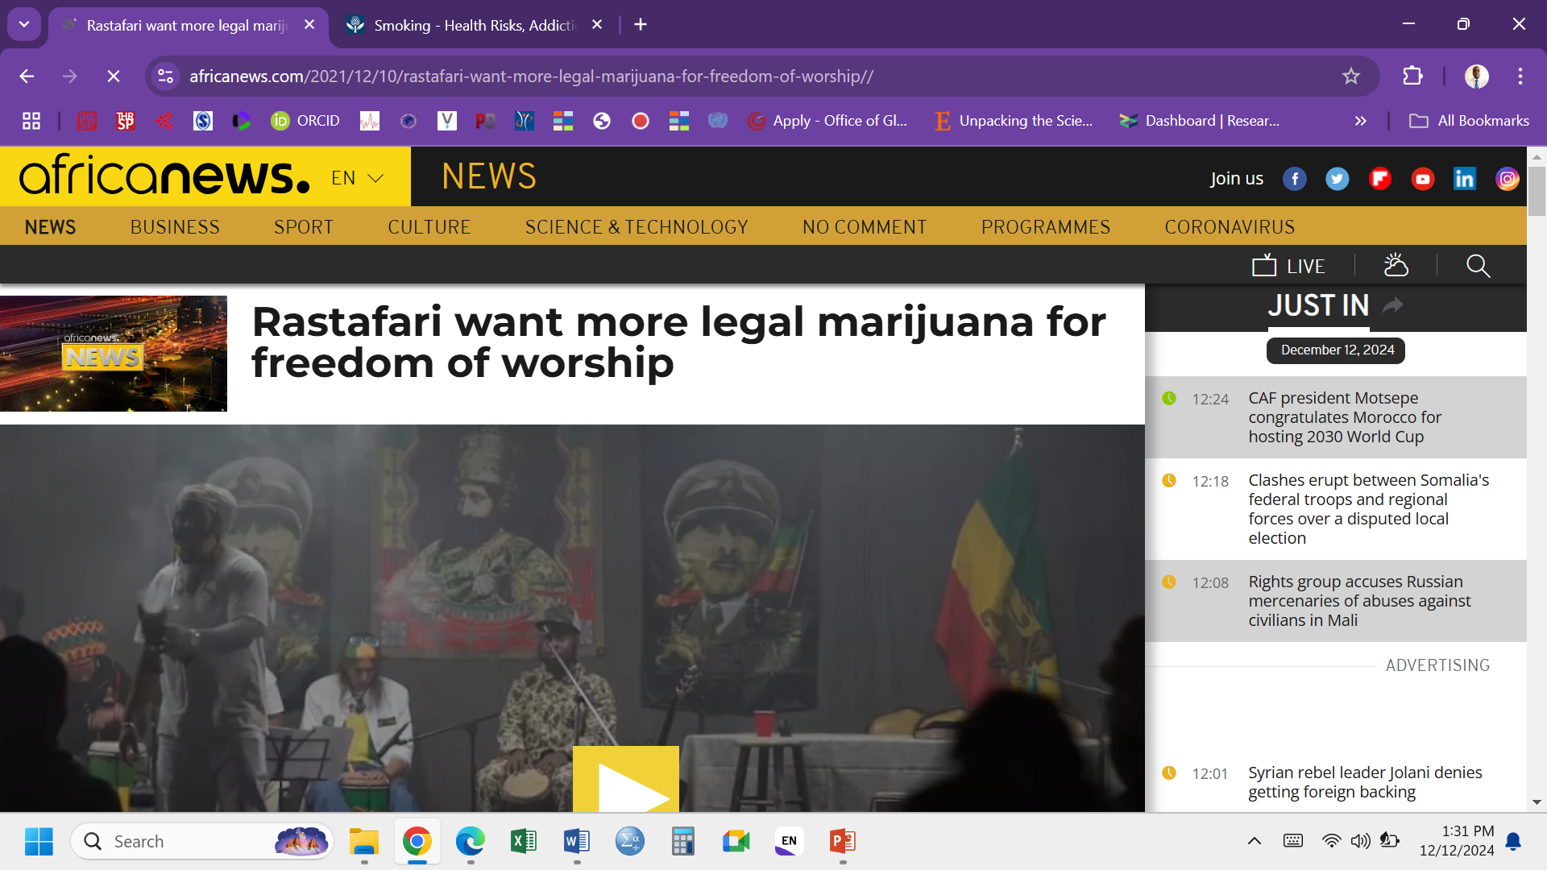
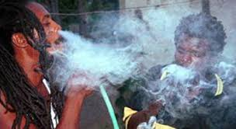
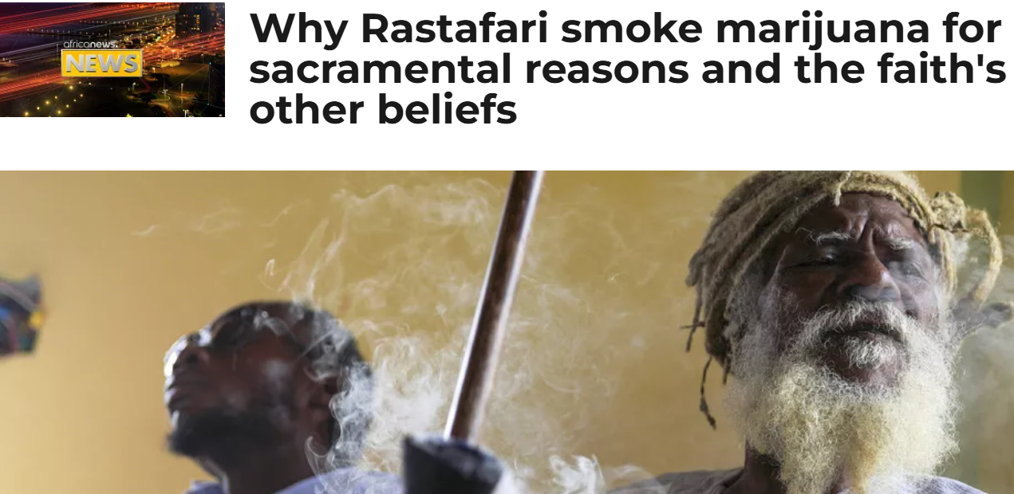
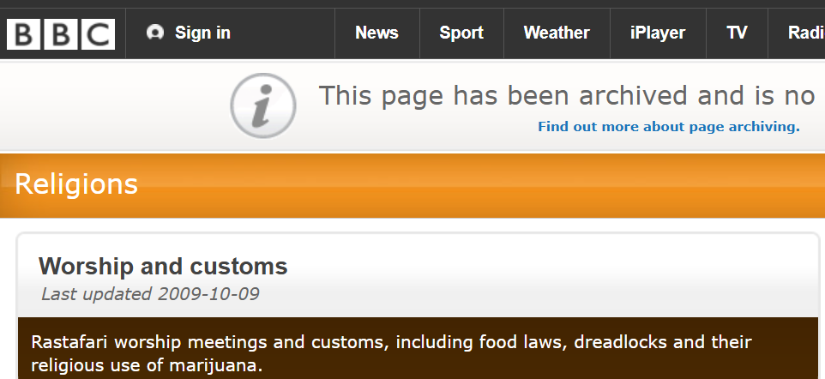

Slide 25
Impact on Tobacco control
Challenges
In cultures where smoking is a social norm, individuals may face social pressure to smoke.
Opportunities
Engaging community leaders and using culturally relevant messages can enhance the effectiveness of interventions on THR and smoke cessation.

Slide 26
Socioeconomic factors in Tobacco use
Individuals with lower SES are more likely to use tobacco and face greater barriers to quitting.
Higher education levels are associated with lower smoking rates, likely due to greater awareness of the health risks and better access to information and cessation resources.
Individuals in lower socioeconomic groups may have less access to these resources, making it harder for them to quit smoking.

Slide 27
Examples of how Social-economic status can influence tobacco use
Income level
Lower-income individuals may use tobacco as a coping mechanism for stress and economic hardship.
Education level
Lower levels of education are associated with higher rates of tobacco use.
Lack of awareness about the health risks of tobacco and limited access to cessation resources contribute to this disparity.
Occupation
Certain occupations, particularly those involving manual labor, have higher rates of tobacco use due to stress and social norms within the workplace.

Slide 28
Impact on Tobacco control
Challenges
  Individuals with lower social economic status may prioritize immediate needs over long-term health benefits.
Opportunities
  Providing affordable cessation resources and integrating tobacco control into broader social and economic support programs can enhance effectiveness.

Slide 29
Intersection of cultural and socioeconomic factors
Cultural and socioeconomic factors often intersect, creating complex patterns of tobacco use.
Understanding this intersection is crucial for developing comprehensive tobacco control strategies.

Slide 30
Examples of intersection between cultural and socioeconomic factors
Rural vs. Urban
In rural areas, cultural norms and economic hardship may combine to create high rates of tobacco use.
In urban areas, socioeconomic disparities and social pressures can influence smoking behaviors.
Marginalized communities
Marginalized communities, such as ethnic minorities and indigenous populations, often face both cultural and socioeconomic barriers to quitting tobacco.

Slide 31
Implementing effective interventions
Tailored interventions
Effective smoking cessation programs should be tailored to consider cultural and socioeconomic factors in Malawi.
Community engagement
Engaging community leaders and stakeholders is crucial for the success of smoking cessation programs.
Community-based approaches can enhance the relevance and acceptance of the interventions.
Customizing messages to resonate with specific cultural values and addressing socioeconomic barriers to accessing cessation resources.

Slide 32
Role of frontline healthcare workers in Malawi
Educating and counseling
Educate patients about the health risks of tobacco use and the benefits of quitting.
Provide counseling, support, and resources to help individuals make informed decisions.
Advocacy and policy implementation
Advocate for stronger tobacco control policies and support their implementation.
Work with community leaders to promote smoke-free environments and access to cessation resources.

Slide 33
Role of frontline healthcare workers in Malawi cont.
Community outreach
Engage with the community to raise awareness about tobacco harm reduction.
Organizing workshops, distributing educational materials, and leveraging local media to spread the message.
Providing support
Offer continuous support to individuals attempting to quit smoking.
Providing referrals to cessation programs, monitoring progress, and addressing any challenges faced during the quitting process.

Slide 34
Post-Module quiz questions
What are some common cultural factors that influence tobacco use?
Religious beliefs
Social norms and peer pressure
Media and advertising
All of the above
2. How does socioeconomic status affect tobacco use?
Higher income leads to higher tobacco use
Lower income leads to higher tobacco use
Socioeconomic status has no effect
Tobacco use decreases with socioeconomic improvements.
3. Which demographic is most likely to use tobacco according to socioeconomic factors?
Older adults
Young adults and adolescents
Middle-aged individuals
Socioeconomic factors do not affect demographics
4. What role does education play in tobacco use?
Higher education levels are associated with higher tobacco use
Lower education levels are associated with higher tobacco use
Education has no impact on tobacco use
Education decreases the risk of starting tobacco use

Slide 35
Post-Module quiz questions
7. How does gender influence tobacco use in different cultures?
Men are more likely to smoke than women
Women are more likely to smoke than men
There is no gender difference
Gender roles in tobacco use vary significantly across cultures
8. Which socioeconomic factor is most associated with higher rates of smoking?
High income
Employment status
Low educational attainment
Urban residence
5. How can cultural beliefs impact smoking cessation efforts?
They can support quitting smoking
They can hinder quitting smoking
They have no impact
Both a and b
6. Which factor is NOT a cultural influence on tobacco use?
Ritualistic use
Family traditions
Physical environment
Media representation

Slide 36
Post-Module quiz questions
9. In what ways can peer pressure affect tobacco use?
It can encourage tobacco use
It can discourage tobacco use
It has no effect
Both a and b
10. Which cultural practice has been known to contribute to the initiation of tobacco use?
Social gatherings
Religious ceremonies
Traditional rituals
All of the above

Slide 37

Thank you for learning

